Slide 1
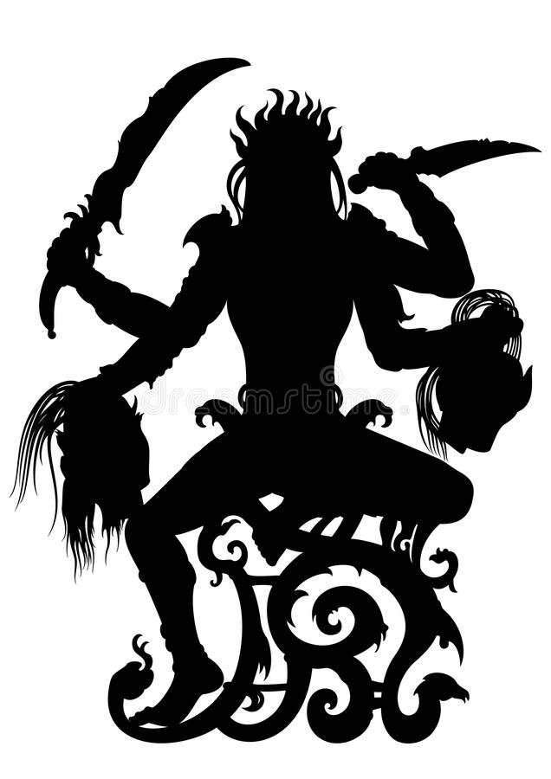


God is a Woman
An Exploration of Victorian Gender Dynamics in Imperial Gothic Literature
Sally E. Cannon; Furman University
BODY
Abroad vs At Home
In H. R. Haggard’s She we have a cohesive, chronological narrative where English aristocratic/professional men are competent
Take the fight home and their competence erodes [and with it, narrative structure goes away]
  ex) The Beetle – multiple narratives in structure and Atherton/Lessingham altercation in detective office
  ex) The Great God Pan – multiple narratives in structure and the men refusing to communicate
  ex) The Goddess a Demon – multiple fighting detectives refusing to communicate because they all want to “win” the case
Inept Male Protagonists
Professional men are overly emotional and/or morally bankrupt in these novels IF drawn from upper class
They make errors that hinder their own progress
  ex) The Beetle - Atherton, Lessingham, Holt
  ex) The Great God Pan - Doctor Raymond, Clarke, Villiers, Austin
  ex) The Goddess a Demon - John, Graham, Ed and Phil Lawrence, Tom Moore
Only figure of male competence and self control is working class detective in The Beetle
  Figure of the future?
Female Threat as Constructed Absence
How is female agency constructed in each?
  ex) The Beetle - feminine agency is gender fluid and unfathomable
  ex) The Great God Pan- female agency is linked to the masculine divine and is also unfathomable (not traditional!)
  ex) The Goddess a Demon - female agency truly absent, masculine construct or illusion
Assumed to be malicious, despite narrative ambiguity
  ex) The Beetle - personal vendetta becomes national threat
  ex) The Great God Pan - Helen not traditional presenting woman; she scares the men by broadening their horizons and they kill themselves because they can’t handle it
  ex) The Goddess a Demon - goddess literally has no will, is an inanimate object that Lawrence uses to achieve his ends [although everyone assumes it was a violent woman doing the big bad]
ABSTRACT
CONCLUSIONS
Working on the assumption that all Imperial Gothic fiction arose in response to specific doubts, fears, or desires within a waning empire, we might ask: what purpose is served by portraying the governing and professional classes as stymied, amoral, or incompetent? What do we make of an adventure story without a hero? A few examples of this pattern in fin de siècle literature are: The Beetle by Richard Marsh, The Great God Pan by Arthur Machen, and The Goddess A Demon, also by Richard Marsh. Marsh and Machen contrast the usual genre conventions of Imperial literature by placing the goddess in Britain, unlike popular novels like She or Heart of Darkness that take place in Africa. Another point of contention in these novels is that, unlike Sherlock Holmes or Talbot Bulstrode (from the sensation novel Aurora Floyd), the protagonists of these novels aren’t competent detective figures or fighters, and generally cannot accomplish the things they set out to do. Certainly not without help.
The main point of interest in these novels, though, is that while the narrators feign and dance around the topic of the goddess, remaining in the dark through their own silly refusal to communicate, the goddess figure herself has her motives superimposed onto her because of her apparent agency, and that agency is never shown in the text. These texts weren’t stories about men facing up against a woman from afar that intends to wreak havoc or create feminine chaos in the manly, orderly, compartmentalized Britain. Rather, these stories end up being a manifestation of the protagonists’ anxieties mapping onto a woman they refuse to try and understand.
Imperial Gothic novels set abroad tend to have structure, cohesion and the Britons came out on top. The male protagonists in these three novels, in direct contrast with the precedents set in sensation fiction, cannot keep Britain in line with rationale and the stark divide between masculine and feminine worlds. Most importantly though, the female threat in these novels is a constructed absence rather than a dangerous presence. The underlying ideas of a poisonous or deadly woman that men create, and culture based on what they’re afraid of goes back much farther than just the late 19th century. Nathaniel Hawthorne wrote a story called Rappaccini's Daughter based on a traditional folk story from Ancient India. The stories I’ve discussed take the premise of this old, foreign tale and apply it to a popular British conglomeration of science fiction, sensation fiction and the imperial gothic. Just as in Rappaccini's Daughter, the genre conventions of these stories read parallel to their content in those regards.
REFERENCES
Bakhtin, Mikhail, and Michael Holquist. The Dialogic Imagination: Four Essays. University of Texas Press, 2000.
Buzwell, Greg. “Daughters of Decadence: the New Woman in the Victorian Fin De Siècle.” The British Library, The British Library, 17 Apr. 2014, www.bl.uk/romantics-and-victorians/articles/daughters-of-decadence-the-new-woman-in-the-victorian-fin-de-siecle.
Carpenter, Edward.
Daly, Suzanne. “The Imperial Gothic.” The British Library, The British Library, 26 Mar. 2014, www.bl.uk/romantics-and-victorians/articles/the-imperial-gothic.
Diniejko, Andrezj. “The New Woman Fiction.” The New Woman Fiction, 17 Dec. 2011, www.victorianweb.org/gender/diniejko1.html.
Haggard, H. Rider. She. Kindle, 1886/Public Domain.
Hawthorne, Nathaniel, and Hyatt Howe. Waggoner. Selected Tales and Sketches. Holt, Rinehart and Winston, 1964.
Machen, Arthur. The Great God Pan. Kindle, 1894/Public Domain.
Marsh, Richard. The Beetle: a Mystery. Penguin Books, 2018.
Marsh, Richard. The Goddess, a Demon. Valancourt Books, 2010.
Mulvey, Laura. “Visual Pleasure and Narrative Cinema.” Feminisms, 1975, pp. 438–448., doi:10.1007/978-1-349-14428-0_27.
Sedgwick, Eve Kosofsky, and Wayne Koestenbaum. Between Men English Literature and Male Homosocial Desire. Columbia University Press, 2016.
Sweet, Matthew. “Sensation Novels.” The British Library, The British Library, 9 Apr. 2014, www.bl.uk/romantics-and-victorians/articles/sensation-novels.
Woolf, Virginia. A Room of One's Own. Alma Classics, 2019.
BACKGROUND
Imperial Gothic Literature - as the British Empire fell apart in the second half of the 19th century, literature attempted to revitalize British pride and nationalism by villainizing potential reverse-colonial threats
  ex) Heart of Darkness
  ex) Dracula
  ex) She
Sensation Fiction - a subgenre of fiction from the 1860s that generally included the following: an impromptu male-protag-as-detective, secrets, and the drama of the British upper classes
  ex) Lady Audley’s Secret
  ex) Aurora Floyd
  ex) The Woman in White
New Woman Fiction - “free-spirited and independent, educated and uninterested in marriage and children, the figure of the New Woman threatened conventional ideas about ideal Victorian womanhood.” (Buzwell)
  in direct contrast with the ideal of the Victorian “angel of the house”
  ex) The Beth Book
  ex) Jude the Obscure
Rappaccini's Daughter (Hawthorne)
  dangerous woman constructed by her scientist father
  poses a threat to the boy who wants to come in and take her
  story originated as an Ancient Indian folktale
ACKNOWLEDGEMENTS
I would like to thank Dr. Gretchen Braun for being my mentor during two years’ worth of Summer Research Fellowships, the Furman Office of Undergraduate Research for the funding to attend NAVSA, and the NAVSA Conference 2019 for inviting me to present!

