Slide 1
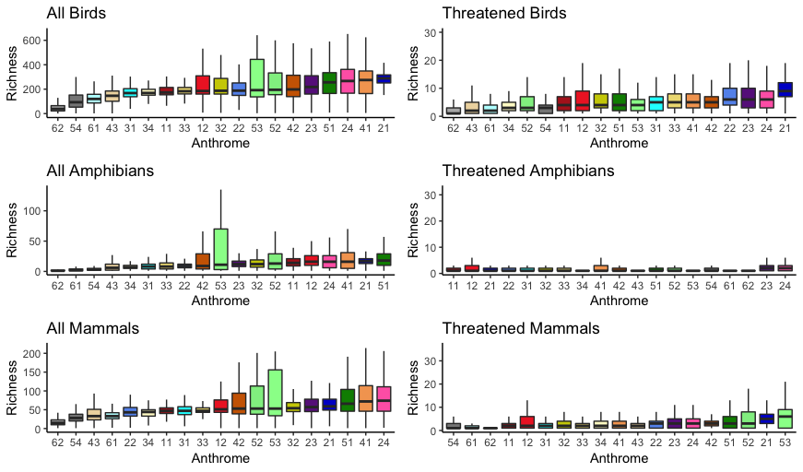
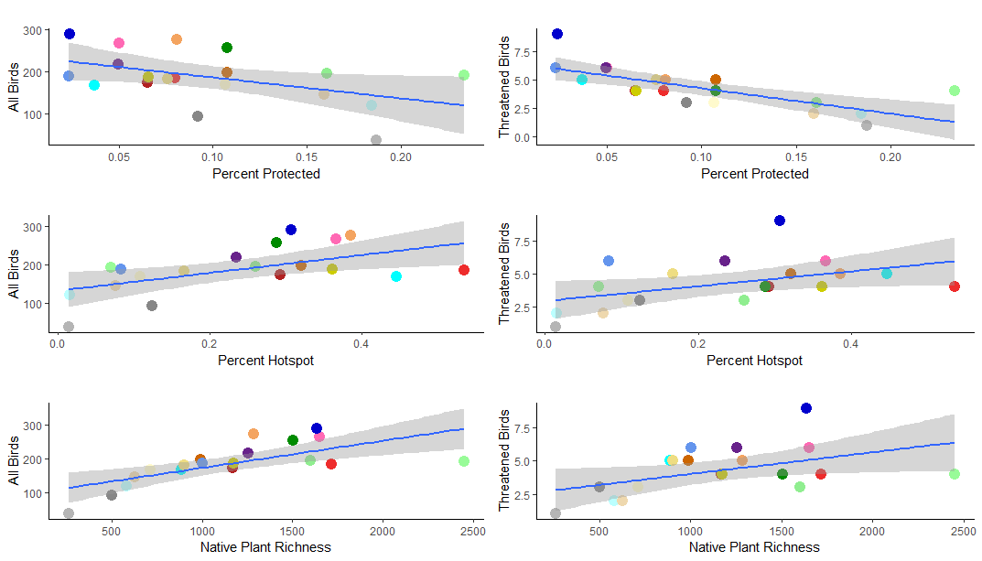
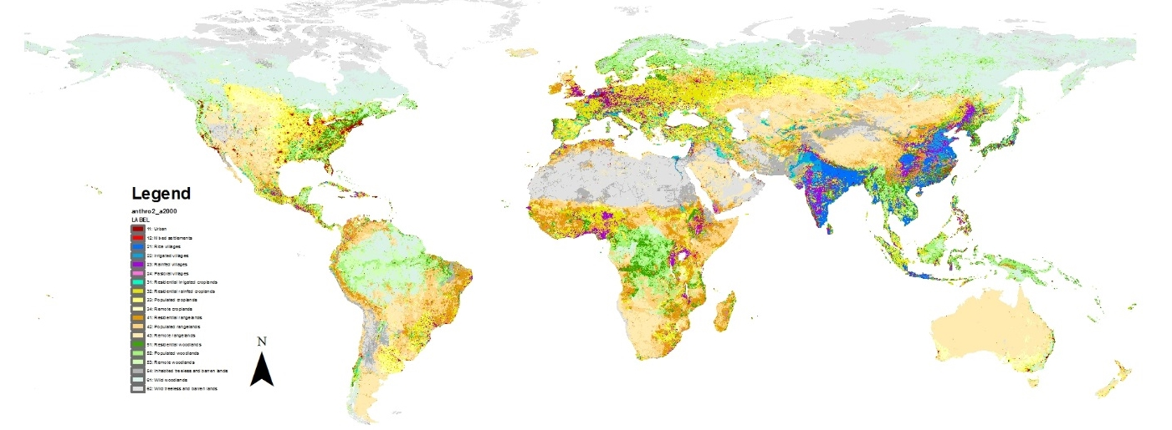
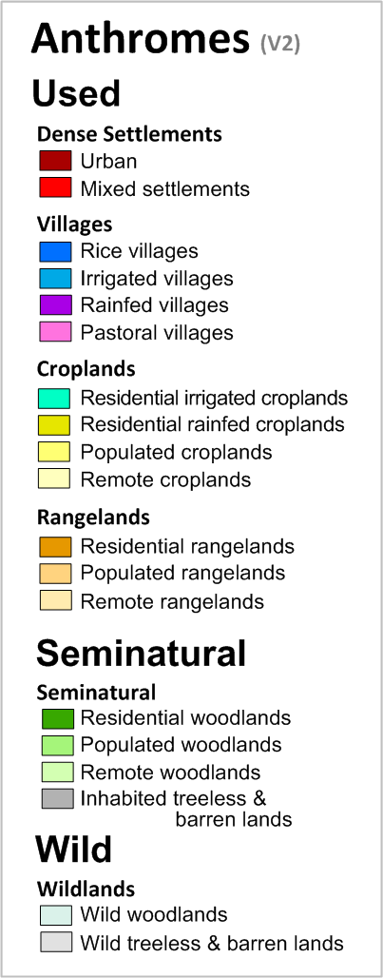
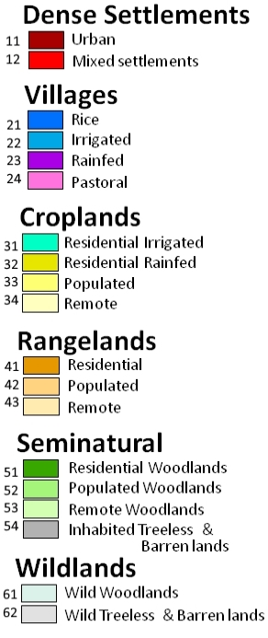
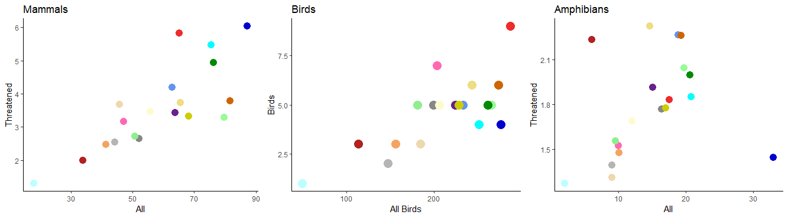
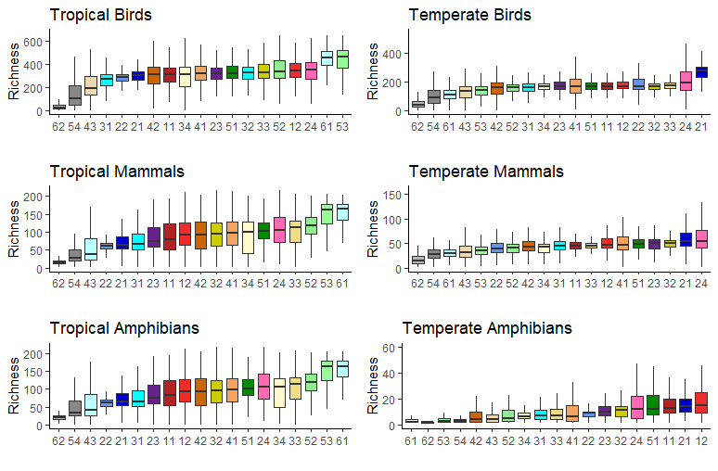
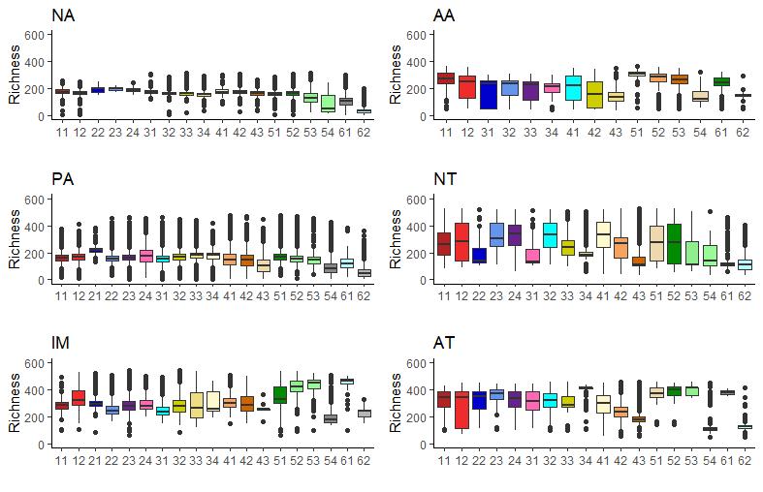
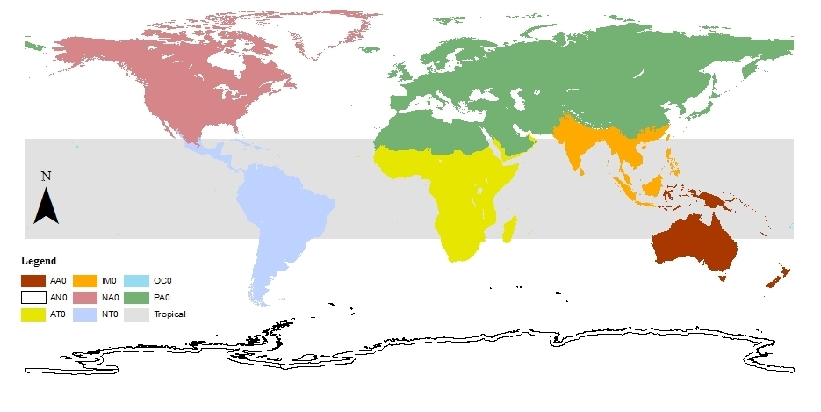
Patterns of vertebrate richness across global anthromes: prioritizing conservation in the Anthropocene
Emma Cook and John Quinn
Furman University, Department of Biology, Greenville, SC 29613
Introduction
Results
Global conservation priorities must be refocused to incorporate human systems
Anthromes integrate human and natural systems, capturing the effect of density and land use on ecosystems
Spatially explicit analyses of global biodiversity patterns across anthromes are limited
Detailed analyses are needed to determine and prioritize anthrome types of importance for conservation
In this project we evaluate patterns of species richness across anthromes and begin to make suggestions for future conservation action at global and regional scales
Global Extent
Relationships
Wildlands consistently have the lowest median species richness
Rice and pastoral villages, residential rangelands, and seminatural woodlands have the greatest median richness
Remote woodlands have the largest variation
The number of threatened birds was greatest in villages and the greatest number of threatened mammals was in remote semi-natural woodlands
The richness of total and threatened birds decreased as a function of area protected
Richness increased with higher proportion of hotspots and increased native species
A similar pattern was evident for mammals and amphibians
Figure 3. Ranked richness of birds, amphibians, and mammals
The relationship between threatened species and total richness was linear for mammals and birds, but more scattered for amphibians.
Low total richness and high threatened richness suggests a clear need for conservation action with that anthrome
Figure 1. Global distribution of anthromes (Ellis et al. 2010)
Figure 7. relationship between bird richness and protected area, hotspot, and plant richness
Methods
Discussion
We used Anthromes version 2.0 for the year 2000 (Figure 1, Ellis et al. 2010) and species richness data for birds, mammals, and amphibians from BiodiversityMapping.org (Jenkins et al. 2013; Pimm et al. 2014). We obtained data about protected areas, hotspots and native plant species by anthrome from Martin et al. (2014).
Figure 4. Relationship between total and threatened
Used and semi-natural anthromes are essential to global conservation efforts
Specific target anthromes vary by geographic region
Richness across protected areas confirm that protected areas do not align with need
More research is needed to refocus conservation action and understand and protect less studied anthromes
Regional Variation
Regional heterogeneity was clear across climates and biogeographic realms
Not surprisingly, tropical anthromes had had greater richness across taxa
Wild woodlands in the tropics had the greatest richness, followed by remote woodlands
In temperate regions, villages and dense settlements had the greatest richness
Bioregions were increasingly complex
Collect anthromes and species richness data
Reproject and rescale richness to match anthromes (→ 5 arc min grid cells)
Use raster calculator to count richness of each grid cell by anthrome type
Count richness at multiple extents: global, tropical vs temperate, and biogeographic realms
Compare richness of total & threatened, and analyze as a function of global protected areas, hotspots, and native plants
Connect to conservation practice
Biomes
Anthromes
CHANS
Protected areas
The matrix
Conservation science
Conservation biology
Place based
Environmental health
Figure 2. Units of analysis used to identify regional patterns.
References
Figure 5. Ranked richness in tropical and temperate regions
Figure 6. Bird Richness by Bioregion
Ellis,. et al. 2010. 1700 to 2000. Global Ecology and Biogeography 19(5):589-606.
Jenkins, et al. 2013 PNAS. 110(28): E2602-E2610.
Martin et al. 2014. Diversity and Distributions. 20:745-755.
Pimm, et al. 2014.. Science. 344(6187): 1246752.

