Slide 1

The Office of Assessment and Institutional Research Presents: Data Dins
Conversations about Furman University Data

Slide 2
Data Dins
Future Focused
Furman University Strategic Plan 2024-2029
1. University of Innovation and Impact
2. Thriving Community
3. Sustainable and Strong Future
Support Employee Growth and Satisfaction
Prioritize faculty and staff wellbeing, engagement, and professional growth.
Foster a positive and enriching campus culture through improved communication and collaboration.
Data Transparency
Student Success
Conversations
Partners

Slide 3

What is your role?
Not a committee or task force – simply a gathering of like-minded individuals invested in seeing our students succeed
Listen, participate, and take actionable information back to your office/division/program
Cross silos – Look at and discuss data across divisions and draw different data sets together around a particular concern
Generate ideas for a new study
https://media0.giphy.com/media/v1.Y2lkPTc5MGI3NjExYnduMXBoNTU5dDVtM25yamh4dWs3aDRodXp4dHBvd2YyMjBheXJlNiZlcD12MV9pbnRlcm5hbF9naWZfYnlfaWQmY3Q9Zw/26gs78HRO8sOuhTkQ/giphy.gif

Slide 4


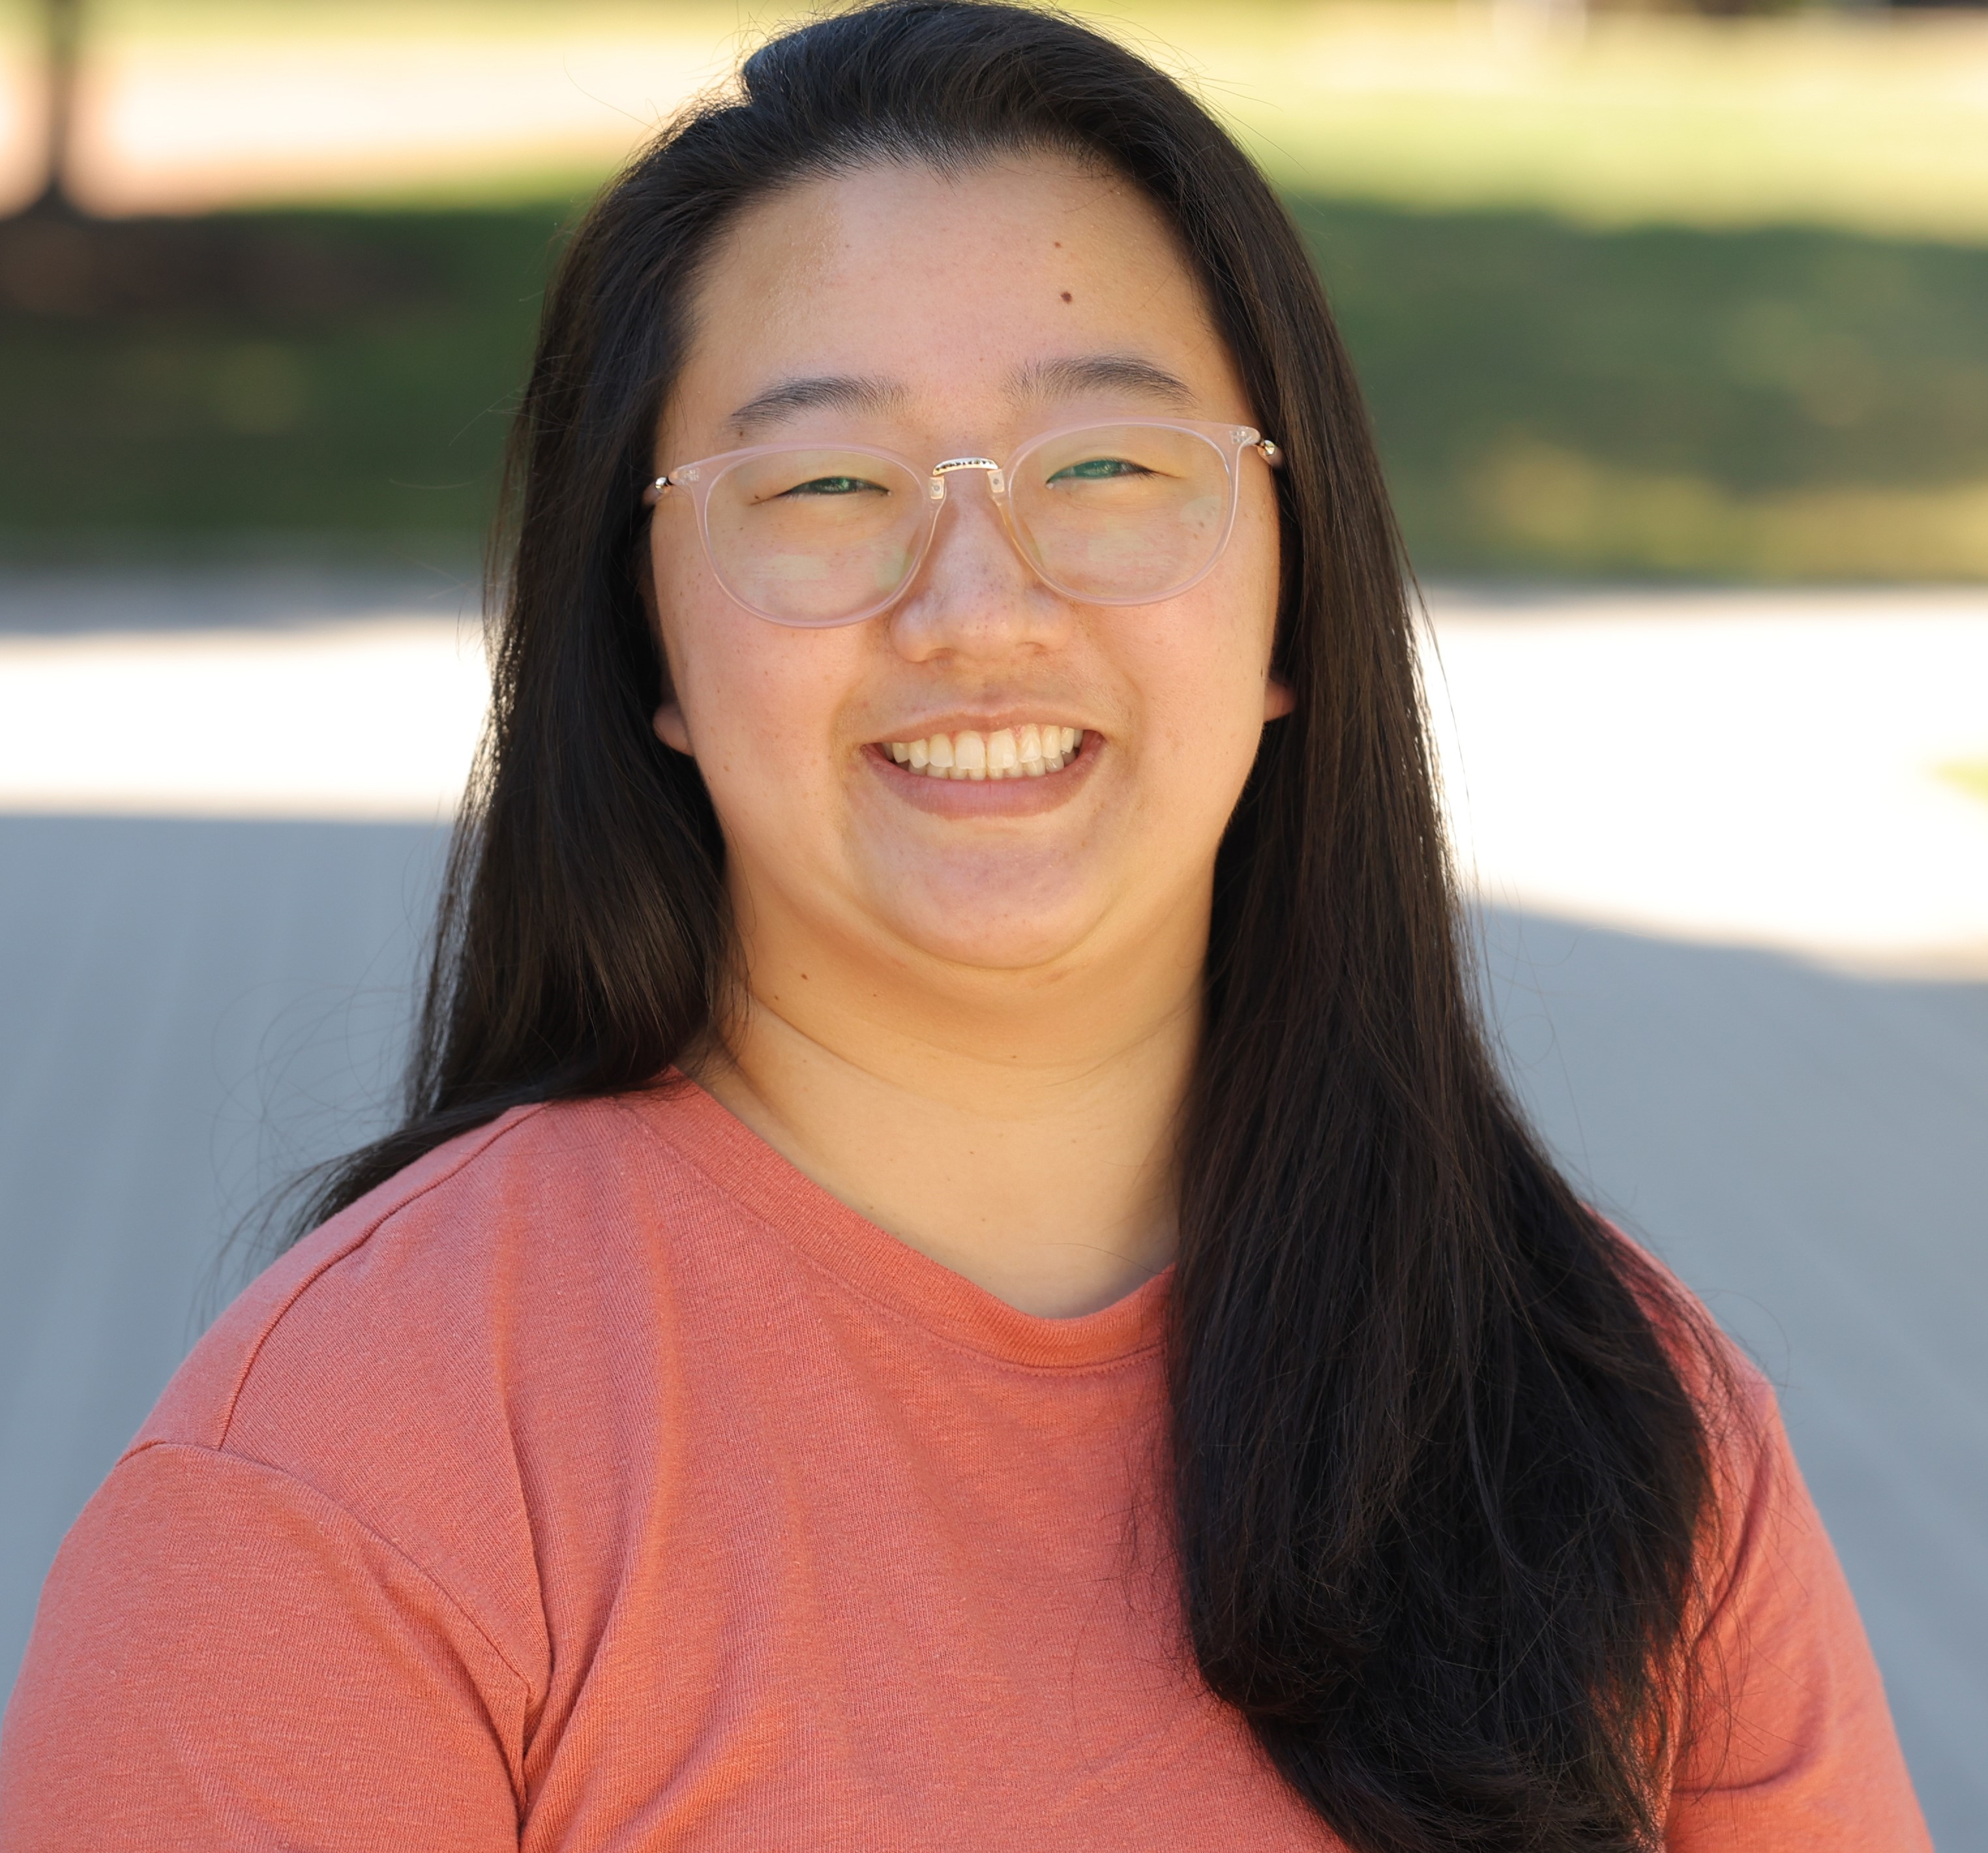
The Office of Assessment and Institutional Research
David Eubanks: Assistant Vice President of Office of Institutional Assessment and Research
Suzanne Klonis: Director of Assessment and SACSCOC Institutional Liaison
Katlyn Bagley-Sepsey: Director of Institutional Research, Reporting, and Data Stewardship

Slide 5
Reminders when viewing the dashboards
Dashboards tell us about the past, not the future.
They tell us about associations between data elements, but these correlations do not imply direct causation.
Over time dashboards can give us confidence in our understanding of key metrics AND help us spot cases where the data is wrong.

Slide 6
Reminders when viewing the dashboards
We shouldn’t build programming directly from dashboards.
Instead, we need analysis, which the IR office can provide.
A successful analysis leads to a proposed model that links metrics, suggesting how they interact.
We can use that model to attempt improvements.
Turn anecdotal “I think” to “I know”

Slide 7
Graduation and Retention Rate Dashboard

Slide 8
Why do we collect this data?
Measure Student Success
Identify At-Risk Populations
Support Strategic Planning
Monitor Institutional Performance
Fulfill Accreditation & Reporting Requirements
Guide Retention and Intervention Strategies
Benchmark Against Peers
Demonstrate Value and Outcomes
Helps pinpoint where students are struggling and which groups may need targeted support.
Informs resource allocation, program development, and student service improvements.
Acts as a key performance indicator for institutional effectiveness and quality.
Required by accrediting bodies (e.g., SACSCOC) and agencies like IPEDS and the U.S. Department of Education.
Helps evaluate the impact of initiatives like advising, first-year programs, and academic support services.
Enables comparisons to similar institutions and national averages for continuous improvement.
Offers transparency to students, families, and the public about educational return on investment.
These metrics reflect how well we support students in completing their degrees on time.
Notes:
Monitor Trends Over Time
Track year-to-year changes in student enrollment to understand growth, decline, or shifts in student populations.
Inform Strategic Planning
Provide data to guide institutional decisions about academic program offerings, staffing, facilities, and budgeting.
Support Resource Allocation
Help campus leaders distribute resources—such as faculty, classrooms, housing, and financial aid—based on actual student needs.
Ensure Compliance and Reporting
Fulfill federal, state, and accreditation reporting requirements (e.g., IPEDS, SACSCOC, Title IV).
Understand Student Demographics
Analyze who our students are (e.g., race/ethnicity, gender, residency, first-gen status) to support equity, access, and student success.
Identify Enrollment Patterns
Examine enrollment by program, major, class level, or modality to detect shifts in student interests or needs.
Enhance Recruitment and Retention Efforts
Identify which populations are enrolling, persisting, or leaving to improve targeted outreach and support strategies.
Communicate Institutional Health
Provide key metrics to leadership, trustees, and the campus community that reflect the vitality of the institution.

Slide 9
How is enrollment counted?
Census A: Taken after drop/add ends; includes early enrollees
Census B (official): Mid-semester snapshot (October 15th)
  Used in various reports
    IPEDS: Integrated Postsecondary Education Data System
    SC CHE: South Carolina Commission on Higher Education
    CDS: Common Data Set
    US News: Rankings
    Other: Peterson’s, Wall Street Journal, Fiske Guide to Colleges, National Student Clearinghouse, South Carolina Independent Colleges and Universities, National Association of College and University Business Officers, Princeton Review, etc.

Slide 10
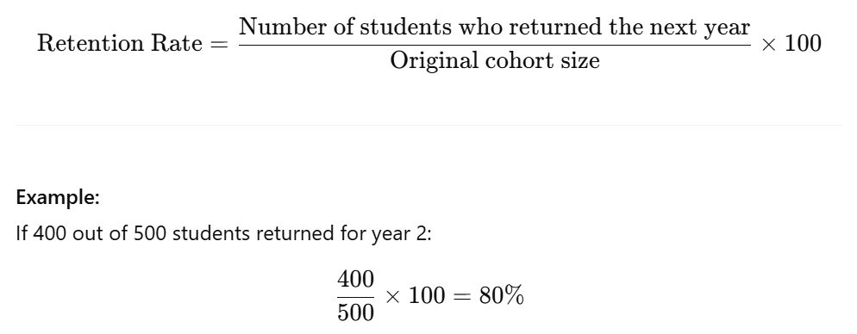
Retention rate
Notes:
Which retention rate “matters?”

Slide 11
Types of retention rates
Cumulative: percentage of a cohort still enrolled at or beyond a specific year
Marginal: the percentage who returned from one specific year to the next
First to second year
Transfers
Notes:
Which retention rate “matters?”

Slide 12
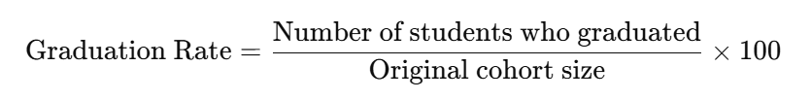
Graduation rate
Fall 2015 Cohort
668 first-time, full-time, first-year enrolled
Graduate in 2019
497
Graduate in 2021
499/668
74%
545
545/668
82%

Slide 13
Type of graduation rates
Four year/100%
Five year/125%
Six year/150%
Eight year/200%

Slide 14
Scavenger Hunt!

Slide 15
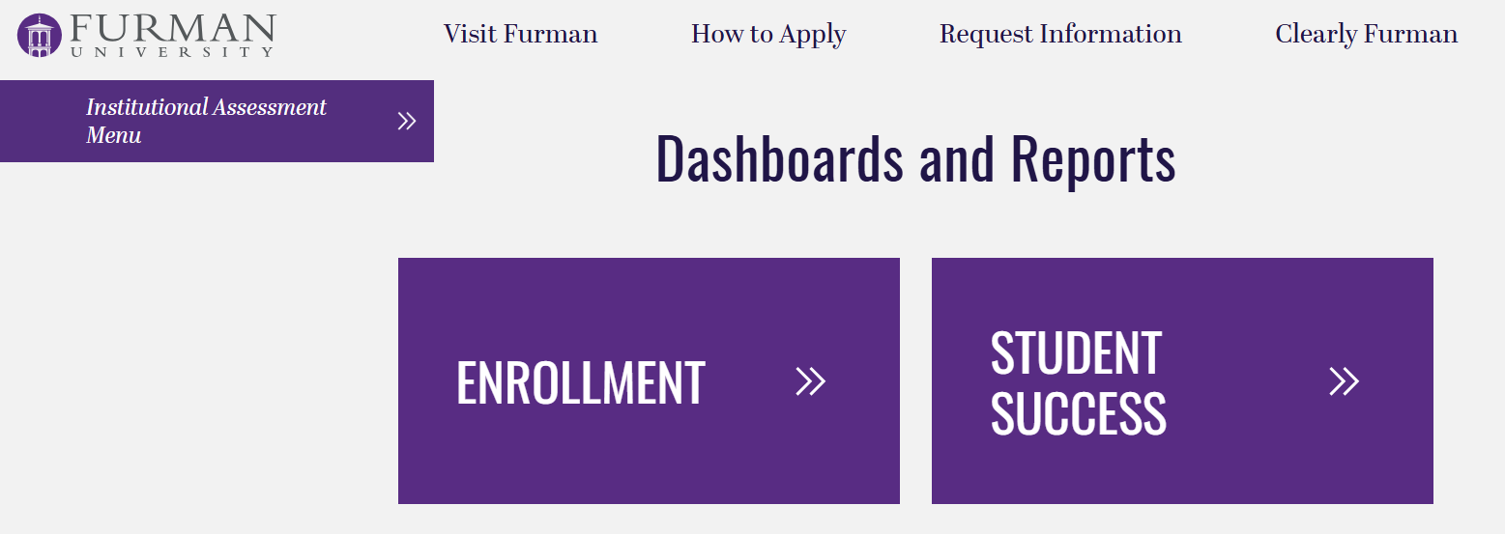
Let’s navigate to the dashboard

Slide 16
Power BI Tips and Tricks
Use Full Screen or Focus Mode
Click the focus icon (⤢) in the top-right corner of a visual to zoom in and see it better.
Hover for Details
Move your mouse over charts and visuals—tooltips will often pop up with extra info.
Click to Highlight
Click a row or pie slice—Power BI will automatically highlight related data in other visuals.
Don't Worry About Breaking It
You can't damage the dashboard by clicking around—explore freely!
Ask Questions
If something looks confusing or unclear, it's totally okay to ask. These tools are meant to support you, not test you.

Slide 17
Student Matriculation and Retention Team (SMART)
Purpose
Cross-divisional team providing leadership and oversight for strategic planning, tactical/operational execution, and accountability for a seamless undergraduate student experience from admission to graduation.
Goals
Improve retention, persistence, and graduation rates
Lessen Attrition and melt
Enhance family/student on-boarding communications and processes
Identify and eliminate unintentional and/or unnecessary student business process barriers
Identify institutional adjustments that require senior administration actions to accomplish

Slide 18
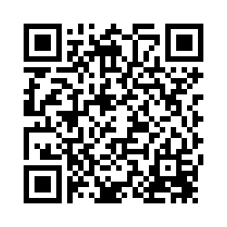
Wrap-up
Thank you for attending!
Don’t forget a sticker
Please complete the evaluation – scan the QR code
Notes:
Also on the handout

Slide 19


The Office of Assessment and Institutional Research Presents:
Garden Chapel Room
Friday, 12:30-1:45pm
Conversations about Furman Data
June 27th: Senior Survey Results
July 25th: U.S. News and World Report
Bring your laptop

