Slide 1

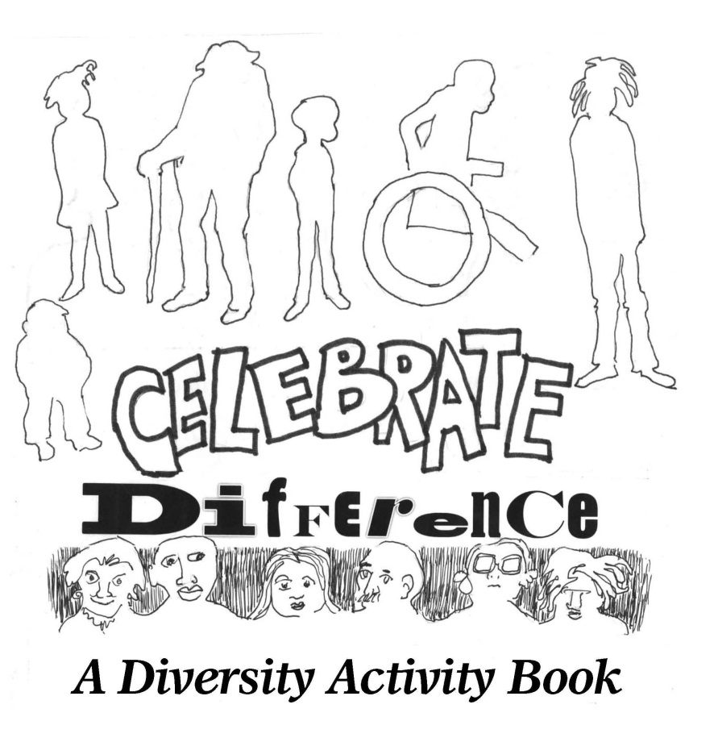
Diversity Leaders Initiative
Spring 2014 Midlands Class – A Team
DIVERSITY ACTIVITY BOOK
The A Team of Furman University’s Spring 2014 Midlands Class created a book to “celebrate” diversity.
UNDERSTAND & CELEBRATING
We will define words that relate to diversity, color pages in the book and discuss differences.
Upscale Dining

Slide 2
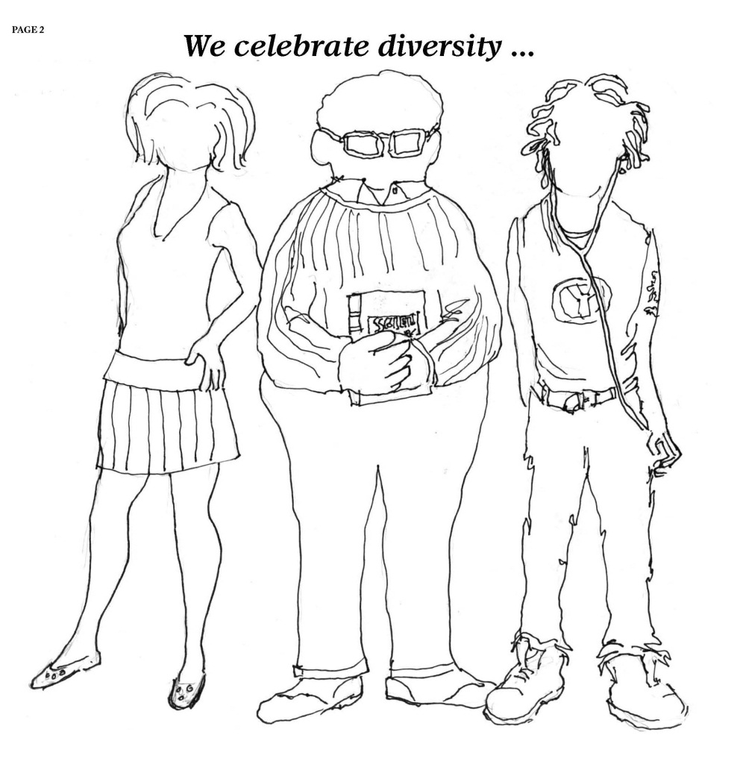
We celebrate diversity…
CELEBRATE
What does it mean to celebrate?
DIVERSITY
What does diversity mean?

Slide 3
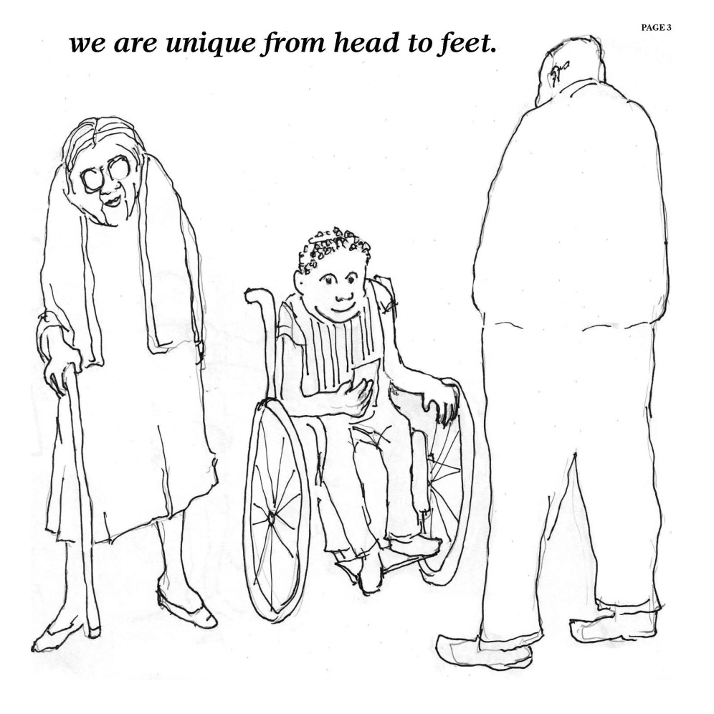
WE Are UNIQUE FROM HEAD TO FEET…
UNIQUE
What does unique mean?
DISCUSS UNIQUE
Name some ways that people can be unique? How
are the people on page 3 unique?

Slide 4
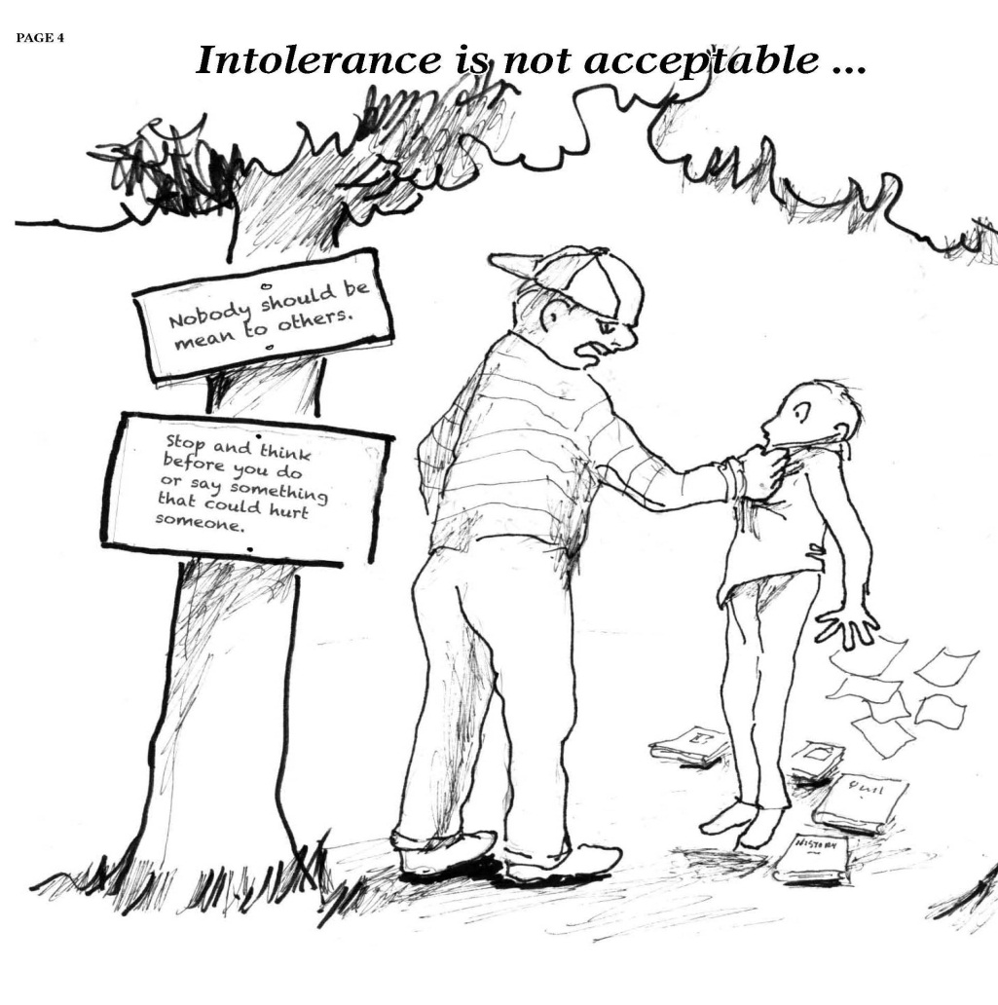
Intolerance is not ACCEPTABLE…
INTOLERANCE
What’s happening in page 4? Define Intolerance.
INTOLERANCE VS. TOLERANCE
Why is acceptance important. Is there a time
for intolerance?

Slide 5
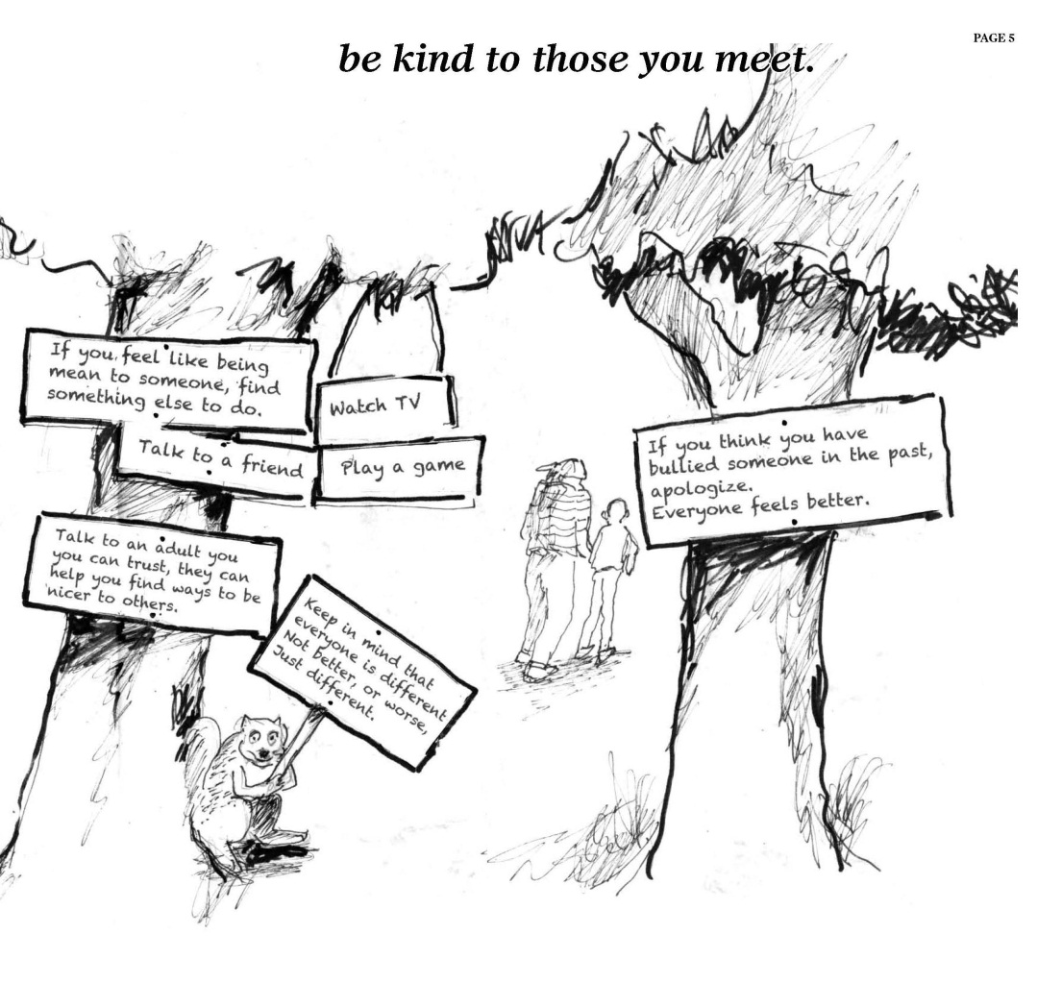
BE KIND TO THOSE YOU MEET…
KINDNESS
Why is it important to be kind to those we
meet?
KINDNESS TO DIFFERENT PEOPLE
Keep in mind that everyone is different not
better or worse…Just different!

Slide 6
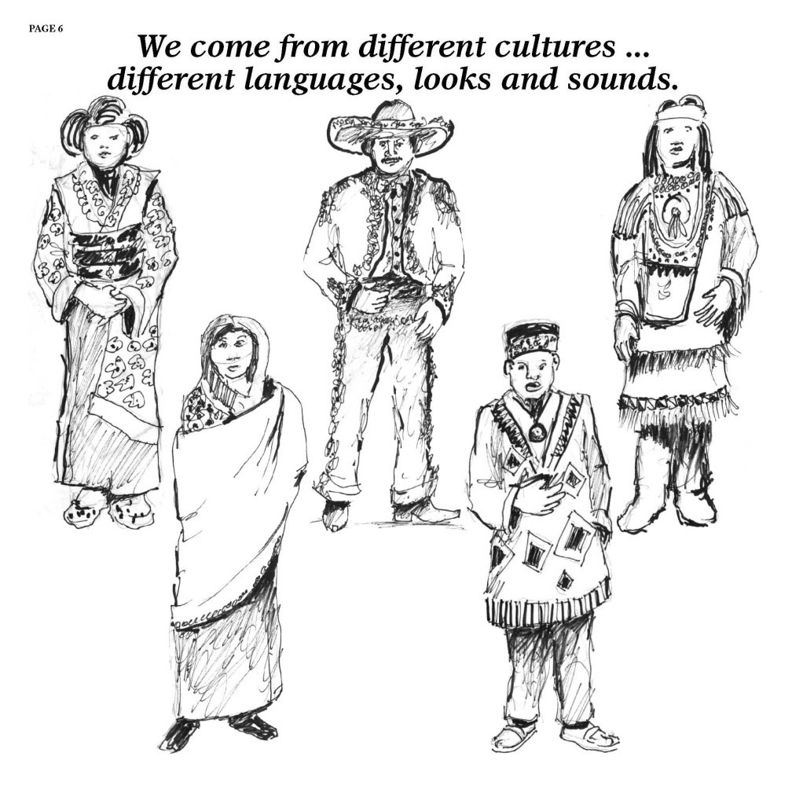
We Come from different cultures…
Different languages, looks and sounds
CULTURE
What does culture mean?
DIFFERENT CULTURES
Languages, clothing, and other optical
difference can be part of cultural differences.

Slide 7
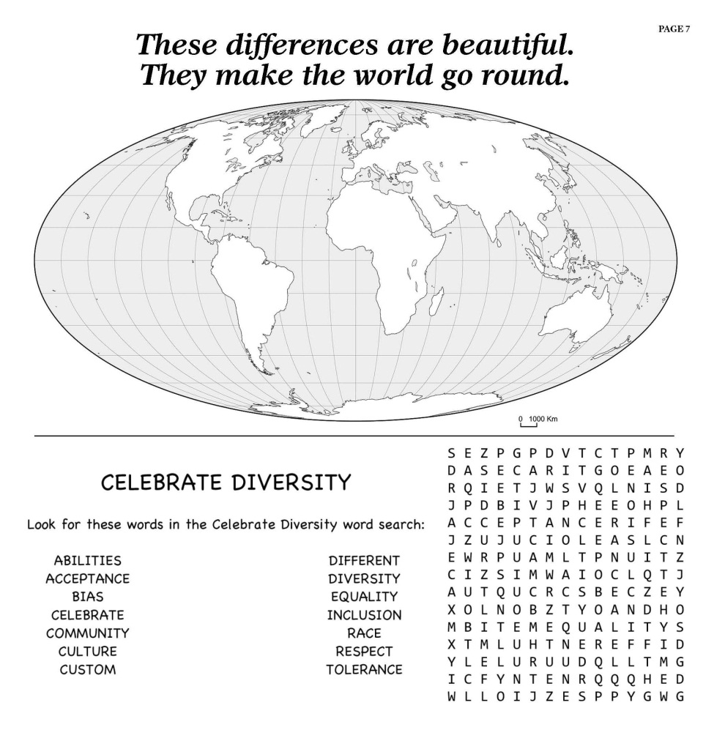
These differences are beautiful…
They make the world go round
WORLD MAP
People come from different countries around the
world.
WORLD SEARCH
Other words that are related to diversity include:
abilities, bias, acceptance, etc.

Slide 8
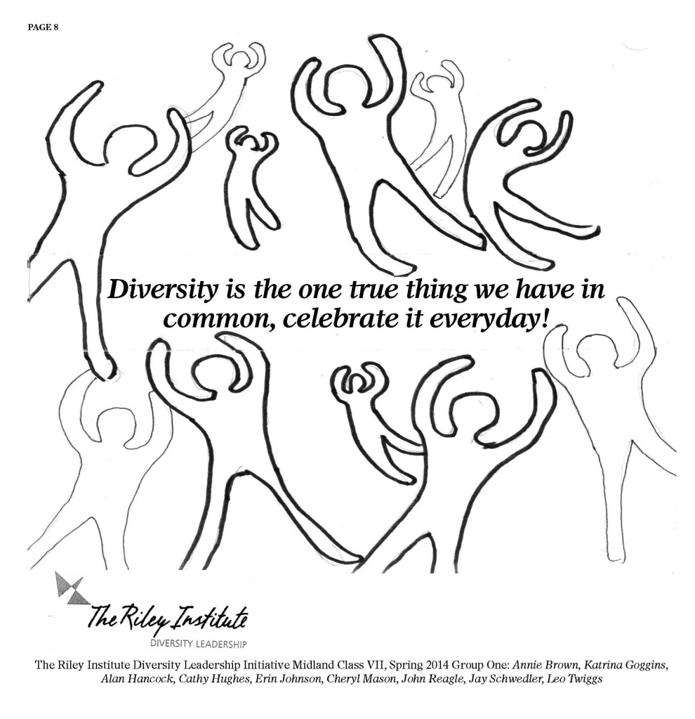
DIVERSITY ACTIVITY BOOK…
Diversity is the one thing we have in common!
ACTIVITY BOOK
Drawing and designs by Leo Twiggs
Born in St. Stephen, SC
The first African-American to receive a doctorate in Art from the University of Georgia
The first visual artist to receive the Elizabeth O’Neil Verner Award for outstanding contributions to the arts in South Carolina
Spring 2014, illustrated “Celebrate Difference”
REVIEW
Diversity, intolerance, kindness, culture,
differences.

